Slide 1

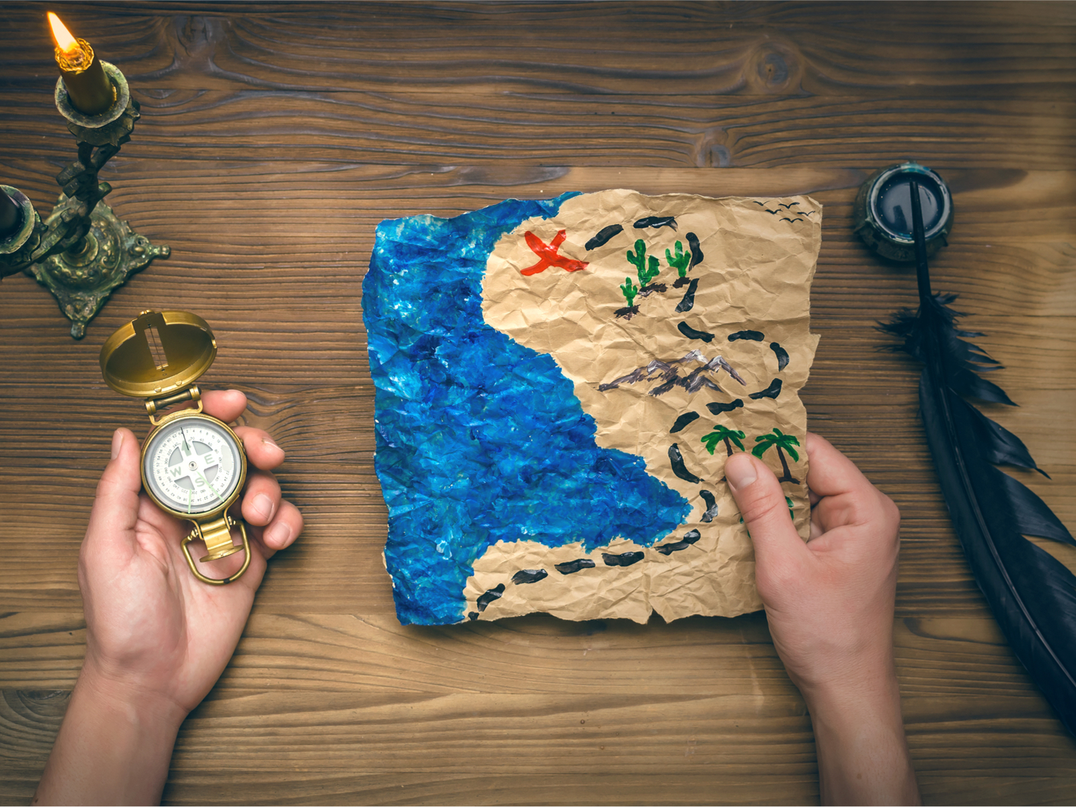

Ether Treasure Hunt Game
Bored-Wizards

Slide 2

Team Members
“Highly enthusiastic about blockchain, games and backend development”
“Having creative vision for designs and technical development”
“Frontend Development Enthusiast with high technical skills”
—Sujan Burman
—Shivam Agarwal
— Tadala Karthik

Slide 3

Problem
Online players have continued to face a plethora of issues with an online gaming site, including, but not limited to:
Data protection.
House edged gambling ensuring that the house always wins.
A lack of transparency in the system
High fees
Fraudulent activity
How blockchain will redefine the gaming industry
Controlling Online Piracy
Ensuring Fairer Profit-Sharing
Managing in-game asset Ownership

Slide 4

SOLUTION
02
01
03
04
Introduction of Treasure Game in Blockchain
More Fair Game Play
Solves Lack of transparency in the System
Decentralization of Data
Firstly — Data will be decentralised which means it is spread across the network and not held in one place – no single individual or institution owns or maintains the data. Secondly — The data cannot be changed or manipulated: it is immutable. The blockchain technology constantly verifies the chains of data, which makes any changes or nefarious activity immediately visible. Thirdly — The entire blockchain infrastructure is secured by complex cryptography that promotes robust data encryption.

Slide 5

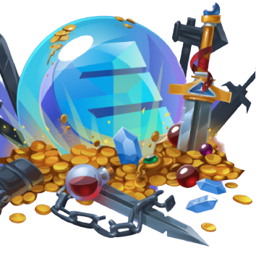
IMPACT
Long-Term Impact
Games in Blockchain will come into mainstream.
Increase in the use of Cryptocurrency
Increase in flow in the market which will inevitably increase the pride of the asset on which this game is implemented will also increase in value.
Short-Term Impact
Users will get better platform to play adventurous games.
Gamers can earn huge cryptos in short time

Slide 6
“I remember going with my mom to a random garbage sale as a kid and thinking what a cool treasure hunt that whole world was.Only to transition as an adult to think 'What a gross place that really is'.”
—Fancy Quotes

Slide 7


DEMO VIDEO

Slide 8
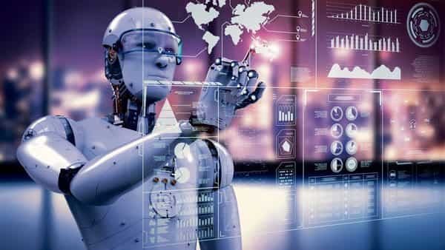


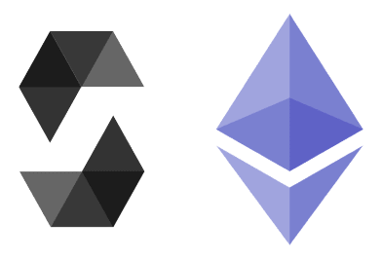



Technology Used
01
React JS
03
05
Tailwind CSS
ethers.js
02
04
Redux
Solidity
06
Truffle

Slide 9
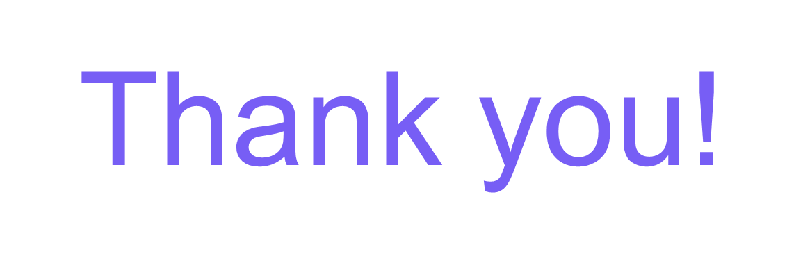
“A MARVELLOUS EVENT. IT DIDN'T FEEL ANYTHING LIKE NORMAL WORK DAYS, BUT PLENTY OF VALUE AND ORGANISATIONAL ALIGNMENT WAS ACHIEVED... NOT TO MENTION IT WAS DAMN FUN!”

